Slide 1
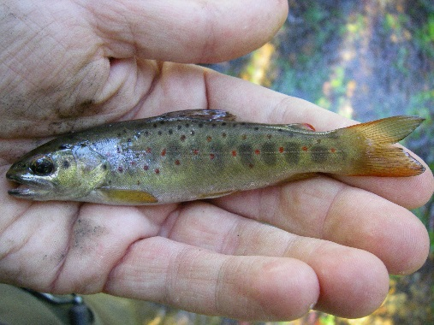
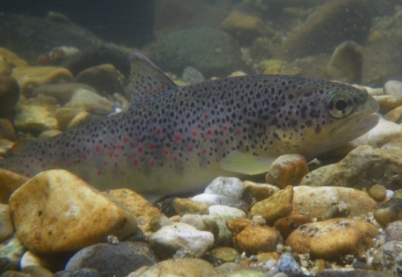
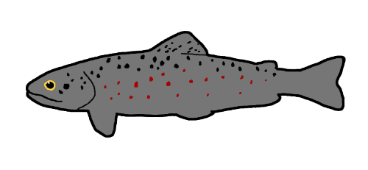
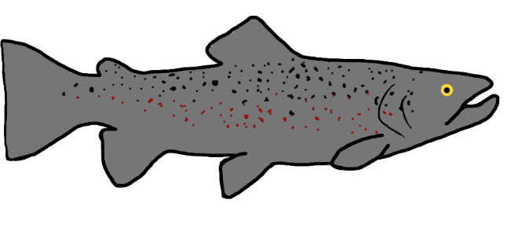

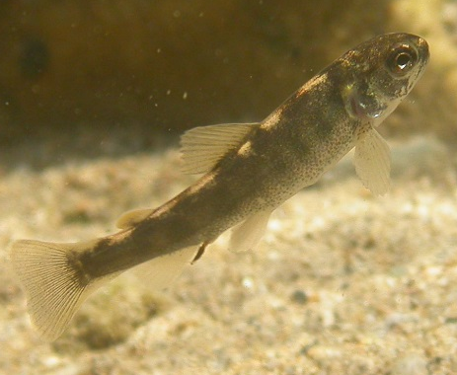
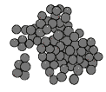
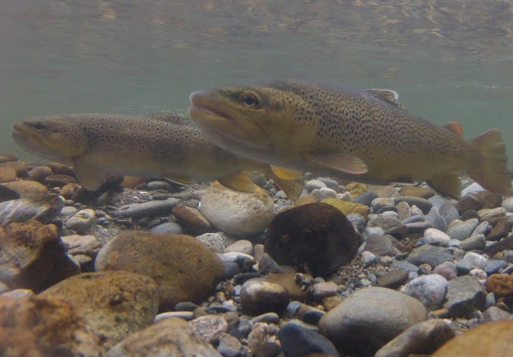
© N. Poulet
Juveniles 1+
© ECOGEA
Adults Ad
Young-of-the-year
0+
Spawning
Œufs Egg
© N. Poulet
© N. Poulet

Slide 2

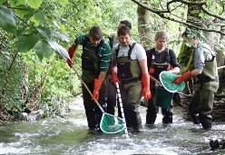






1+
Biotic mortality
0+
$$\text{1}$$
12
$$Ad$$
$$2$$
>$2$
Biotic mortality
Biotic mortality
10
1
$$0$$
0
Ad
12
Ad
Biotic mortality
2
E
Biotic mortality
Egg
$${\text{E}}_{V}$$
$${\text{Ad}}_{Spw}$$
3
Abiotic mortality linked to high flow velocities
Spawning
$$Egg$$
$${\text{E}}_{i}$$
Under-gravel mortality

